Slide 1


AUTOMATED DATA EXTRACTION, TRANSFORMATION AND MERGING

Slide 2
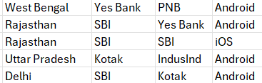
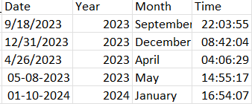



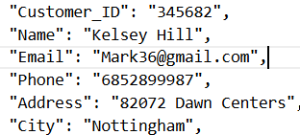

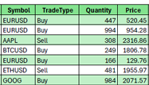
Real Data
Sometimes Sucks...

Slide 3

WHAT THE TOP COMPANIES SAY
80%
of analysts’ time is spent preparing and cleaning data instead of analyzing it.
-McKinsey
70%
of financial institutions say poor data quality directly delays regulatory compliance reporting
-Gartner
of banks admit their customer data is scattered across incompatible systems—making simple tasks like KYC validation painfully slow.
89%

Slide 4

PROBLEM STATEMENT
MORE TIME FIXING DATA THAN FINDING INSIGHTS.
Manual & Slow: Endless Excel juggling
Error-Prone: Duplicates, mismatches, broken formats
Uncertain Accuracy: Never fully sure the data can be trusted

Slide 5
SOLUTION
Beyond Basic Data Processing – We Deliver “Data with Quality”
Automated ETL → Extract, Clean, Transform & Merge.
Data Trust Score → Reliability percentage assigned to each dataset.
Error Logs & Audit Trail → Every anomaly, missing field, or schema mismatch is captured in a detailed error log file, making issues transparent and traceable for compliance teams.
Explainable Insights → Dashboard explains errors & trends in plain English, not just charts.
MISSION

Slide 6
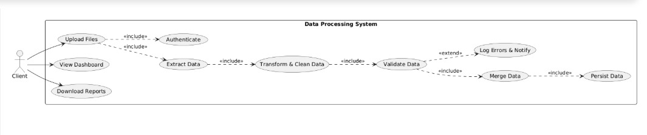
UML DIAGRAM

Slide 7

TECH STACK
“Powered by a modern, scalable tech stack — built for performance, flexibility, and seamless user experience.”
FRONTEND – React.js, Tailwind CSS → Responsive and dynamic user interface
BACKEND – Python, Node.js, Express.js → Scalable APIs and efficient data processing
DATABASE – MongoDB → Flexible, high-performance data storage

Slide 8
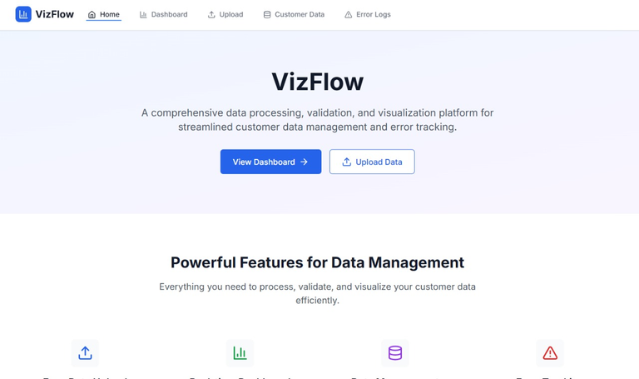
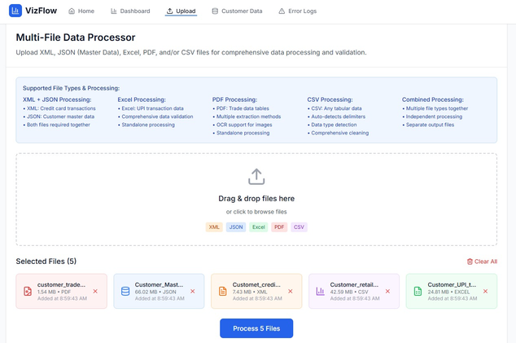
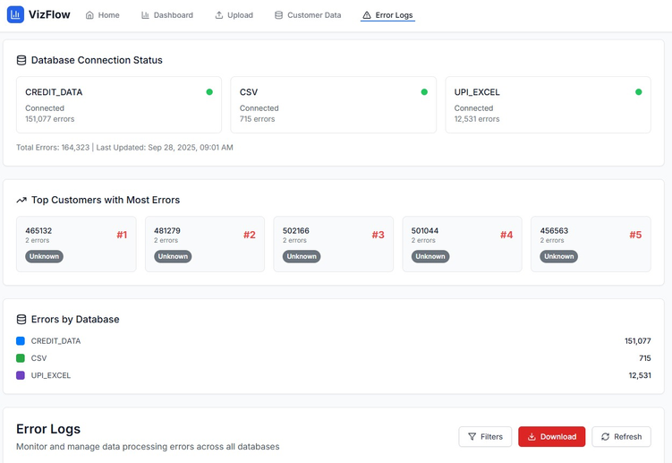

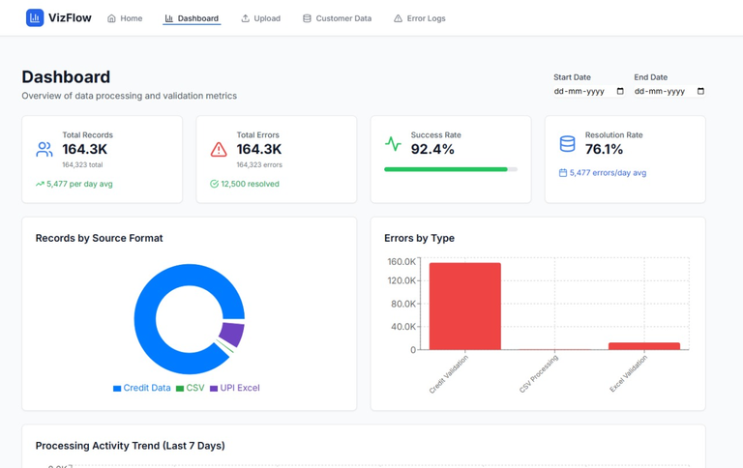
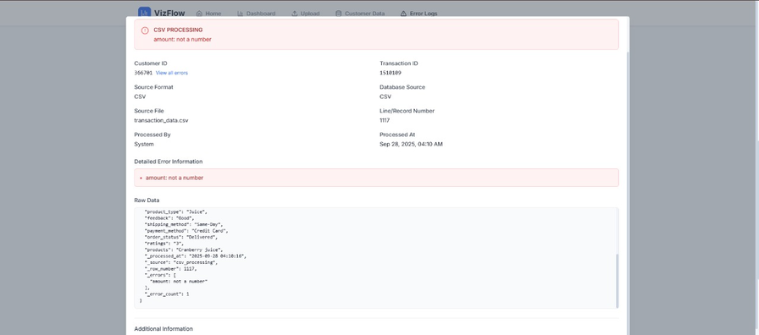
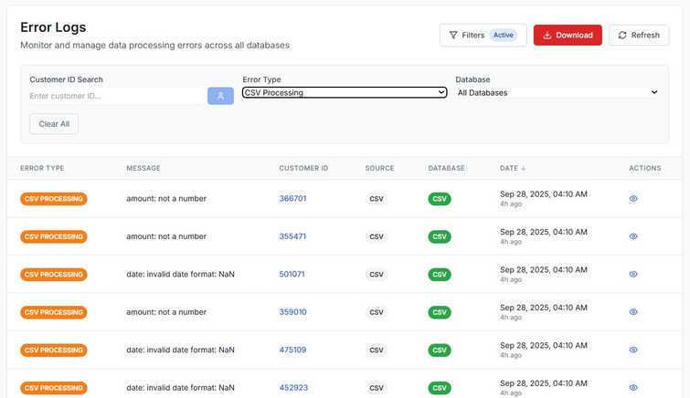

Slide 9

WHY US??
“WE DON’T JUST PROCESS DATA — WE BUILD TRUST IN DATA.”
Data Quality as a Service.
Gain - Time, Cost, Risk Reduction.
Works with ANY DATA, ANY FORMAT! – from CSV, Excel, JSON, XML, to PDFs.
Goes Beyond Basic Cleaning – automatically extracts, cleans, transforms, and merges data into one standardized view.
Trust & Transparency, Not only do we process data, but we also assign a Data Trust Score & give explainable insights in plain English, so that our client or the end user can know which data they could really rely on.

Slide 10


USER EXPERIENCE
Human Friendly UI (Abstraction)
Seamless Onboarding – quick setup, minimal learning curve
Clean Interface – intuitive dashboards and navigation
Real-time Feedback – instant visibility into data quality improvements
Consistency – standardized views across all data sources
Trust & Reliability – accurate, validated, and compliant data delivery

Slide 11
FUTURE WORKS
Iterative Model
AI-Driven Insights – predictive data quality scoring and anomaly prevention
Self-Service Platform – no-code interface for business users
Scalability – support for enterprise-level big data pipelines
Integration Ecosystem – connectors for BI tools, ERP, and cloud platforms
Advanced Security – enhanced data privacy and regulatory compliance modules

Slide 12
CONCLUSION
“From messy files to meaningful insights — in minutes, not hours.”
EFFICIENCY → Automates extraction, cleaning, merging
TRUST → Validated, compliant, and reliable data
CLARITY → Dashboards & chatbot make insights accessible to all

Slide 13
THANK YOU
FOR YOUR KIND ATTENTION

